Slide 1
Midterm Exam Review
Midterm test has 26 questions covering Chapters 1 - 5 of the Malvino, Bates and Hoppe text, along with material from class discussions along with the labs done so far.
Auto-graded test with many short answers, most requiring calculations, to be completed within 4 hours upon starting.
Test is an open book, open note out-of-class test on I-Learn. Power Point class slides, along with homework and lab keys published during this semester can also be referenced. But -- You may not communicate with anyone except the instructor regarding how to answer these test questions. This means that pursuing answers on the internet is not allowed for these test questions, as that is considered communicating with others.
This test counts for 12.5% of overall grade, as does the final.
Canvas truncates unnecessary zeros in Numeric Questions. For example, an answer of 3.00 entered into the answer box of a Numeric Question will be truncated to 3 in the answer box, because the last two zeros are not necessary to accurately represent the number. Whereas an answer of 3.01 entered into the answer box will not be truncated. So a numeric answer entered into the answer box and then truncated by Canvas simply means that the number you entered contains extra zeros at the end, and has no bearing on whether or not your answer is correct.
Test Suggestions:
1.) While you have a few days during which to take the test, once it is open it is to be completed within 4 hours.
2.) Know how to do HWs, as several questions similar to HW problems.
3.) Test focuses on material discussed in class, along with HW and Labs.
4.) If you understand the HWs and labs, you should do well on this test.

Slide 2
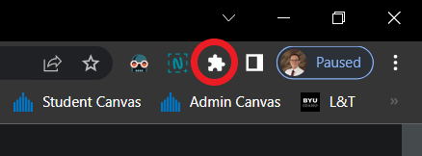
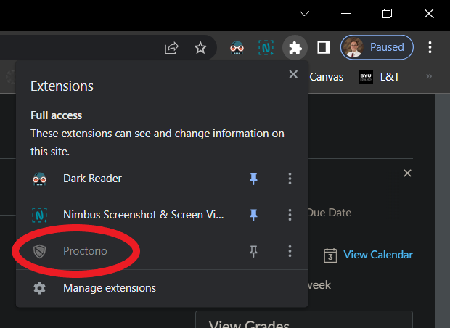

Remote Proctoring - Proctorio
Before Your Exam
Download the Proctorio Chrome extension https://getproctorio.com/.
Use Chrome and update your browser to the latest version and clear cache/cookies before the test. https://help.crelate.com/en/articles/4120395-clearing-your-cache-updating-google-chrome.
Charge or plug-in your computer, and eliminate interruptions.
If you are asked for a code to take the exam, delete and re-install the Proctorio Chrome extension https://getproctorio.com/.
During Your Exam
Once started, you have 4 hours to complete the exam.
You can leave the room during the exam, although try and minimize walking around.
If you experience technical difficulties, click the shield icon (browser bar, upper right).
Next, click on the Proctorio Extension icon.

Slide 3
Cheating/Plagiarism
“This week I am going to give you two examinations: one in Electronic Devices and Circuits and one in Honesty. I hope you will pass them both. But if you must fail one, let it be on Electronic Devices and Circuits. For there are many good people in the world today who cannot pass an examination in Electronic Devices and Circuits, but there are no good people in the world today who cannot pass an examination in Honesty”. Paraphrasing from “As a Man Soweth” by L. Tom Perry, April 1976 General Conference.
“Integrity includes virtue, cleanliness, and honesty. In our world there is so much of deceit. We learn of cheating in the classroom, cheating in business, cheating in marriage, and so on. Even though these acts may not be discovered by others, the soul of a cheater suffers. Self respect vanishes, conscience is warped and character crumbles”. President Nelson.
First item on the CES Honor Code is “Be Honest”.
You will be ask if you are honest when renewing your Ecclesiastical Endorsement. Strive to be able to provide an honest answer to the honesty question.
Demonstrating integrity and trustworthiness is of more long term value than the letter grade you get in any college class.
People cheat to get ahead, but ironically end up further behind in the long term. Be wise!
100% of BYU-I Students that knowingly cheat in their classes regret or will regret their cheating.

Slide 4
ECEN 350 – Topics
Semiconductor Physics
Rectifiers
Zeners
Diodes
BJTs
MOSFETs
CMOS
LEDs
Transistor Biasing
Small-Signal Analysis
Amplifier Gain Stages
Frequency Response
Op-Amps

Slide 5
Electron Energy Bands
E_{g} = 1.43 eV for Gallium Arsenide
E_{g} = 1.1 eV for Silicon
E_{g} = 0.67 eV for Germanium
Increasing Electron
Energy
Conduction Band
Lowest energy unfilled band
At T = 0 Kelvin. (Absolute Zero)
E_{C}
Energy
Bandgap
E_{g}
Valence Band
Highest energy filled band
at T = 0 Kelvin. (Absolute Zero)
E_{V}

Slide 6
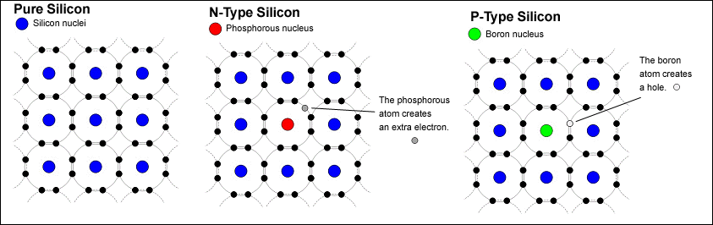
Doping of Semiconductors
n-type Silicon – Doped with Donor atoms – donate an electron (n – negative).
n- type: Electron → Majority carrier. Hole → Minority carrier.
p-type Silicon – Doped with Acceptor atoms (holes) – accept an electron (p positive).
p-type: Hole → Majority carrier. Electron → Minority carrier.

Slide 7
Semiconductor Basics - Summary
Silicon is presently the most important semiconductor material in our world.
Intrinsic – pure. Can achieve 1 part in 10 billion for silicon. Number of electrons in the conduction band equals the number of holes in the valence band.
Extrinsic – doped.
Doping – significantly changes characteristics of material. 1 part in 10 million.
n-type Silicon – Doped with Donor atoms – donate an electron (n – negative).
n- type: Electron → Majority carrier. Hole → Minority carrier.
p-type Silicon – Doped with Acceptor atoms (holes) – accept an electron (p positive).
p-type: Hole → Majority carrier. Electron → Minority carrier.
n and p type silicon (5:59)

Slide 8
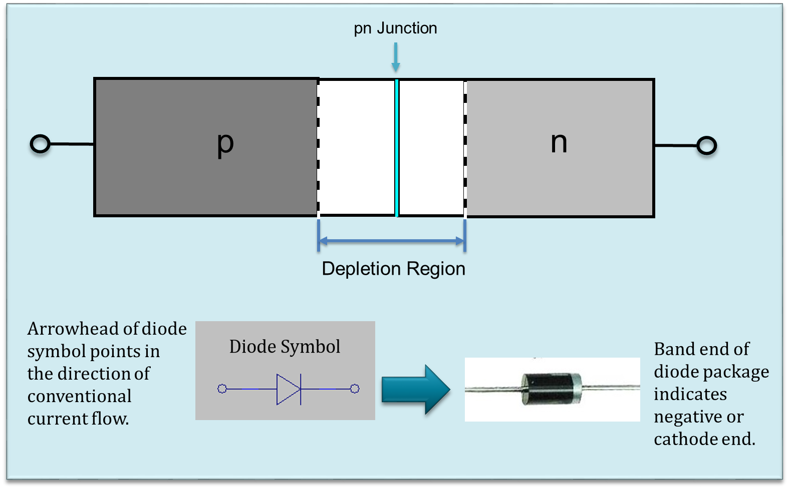
pn Junction Diode

Slide 9
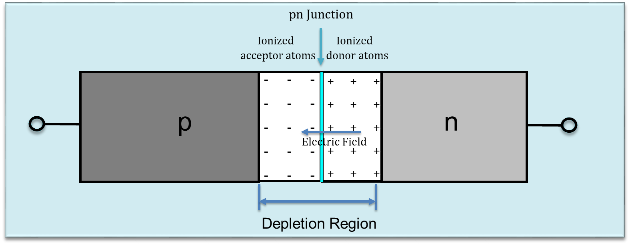
pn Junction
Near the junction, conduction band electrons from n-side diffuse across the junction filling holes on the p-side, resulting in ionized acceptor atoms, i.e. atoms having a net negative charge because of an extra electron.
Near the junction, the loss of conduction band electrons from the n-side also results in fixed donor atoms with net positive charge.
Near the junction, fixed ions result in an electric field that opposes and limits diffusion and results in a potential barrier.

Slide 10
Semiconductor Basics – Review Quiz
(True/False) Minority carries exist in an intrinsic semiconductor?
False. In an intrinsic (pure) semiconductor the number of holes equals the number of electrons, hence no majority or minority carriers.
(True/False) Doping increases the conductivity of a semiconductor for a given temperature?
True. Doping dramatically increased the conductivity of a semiconductor for a given temperature.
(True/False) Conduction band electrons and valence band holes have the same mobility under the influence of an electric field.
False. In silicon conduction band electrons are 2 – 3 times more mobile than valence band holes, due to proximity to the atomic nucleus.

Slide 11
Semiconductor Basics – Review Quiz
In semiconductor vernacular, What is a hole?
Absence of a valence band electron.

Slide 12
Semiconductor Basics – Review Quiz
In silicon at room temperature, doping with atoms that have one more valence band electron than silicon dramatically increases which of the following:
a). Conduction Band Electrons.
b). Valence Band Holes.
a) – Conduction Band Electrons, because the introduced impurity atoms have an extra electron in the valence band that is not associated with a covalent bond with adjacent silicon atoms. Hence this extra electron is loosely bound to the parent atom and easily becomes a conduction band electron.
With the doping describe above which of the following is the resulting semiconductor?
a). n - type.
b). p - type.
a) n – type. More electrons than holes.

Slide 13
Semiconductor Basics – Review Quiz
In silicon at room temperature, doping with atoms that have one less valence band electron than silicon increases which of the following:
a). Conduction Band Electrons.
b). Valence Band Holes.
b) – Valence Band Holes, because the introduced impurity atoms have one less electron in the valence band resulting in a missing covalent bond with adjacent silicon atoms. Hence valence band holes are increased, one for each impurity atom introduced.
With the doping describe above, which of the following is the resulting semiconductor ?
a). n - type.
b). p - type.
b) p – type. More holes that electrons.

Slide 14
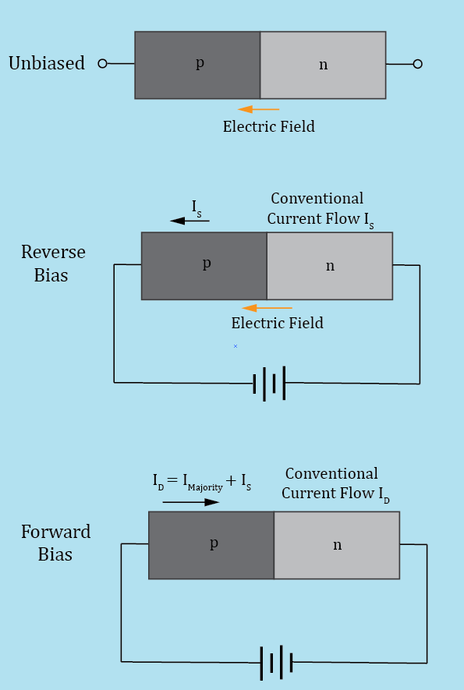
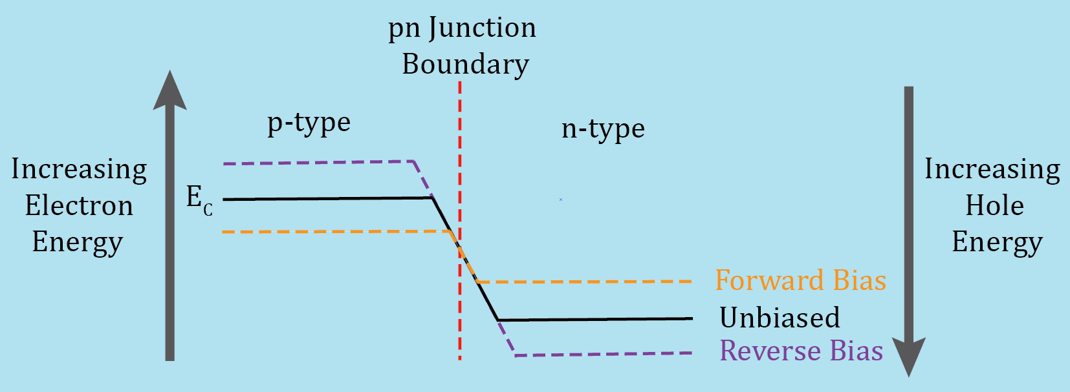

pn Junction Operating Regions
Barrier Potential = $\frac{Work}{q}$ i.e. energy per charge equals volts.
Connecting an external voltage source across the diode terminals alters
the electron energy band difference and barrier potential across the pn
junction as shown below for the conduction band.
Applying a reverse bias voltage widens the depletion region, increasing the
energy band difference and barrier potential of the junction.
Applying a forward bias voltage narrows the depletion region, decreasing
the energy band difference and barrier potential of the junction.
pn Junction Diode Video (10:36)

Slide 15
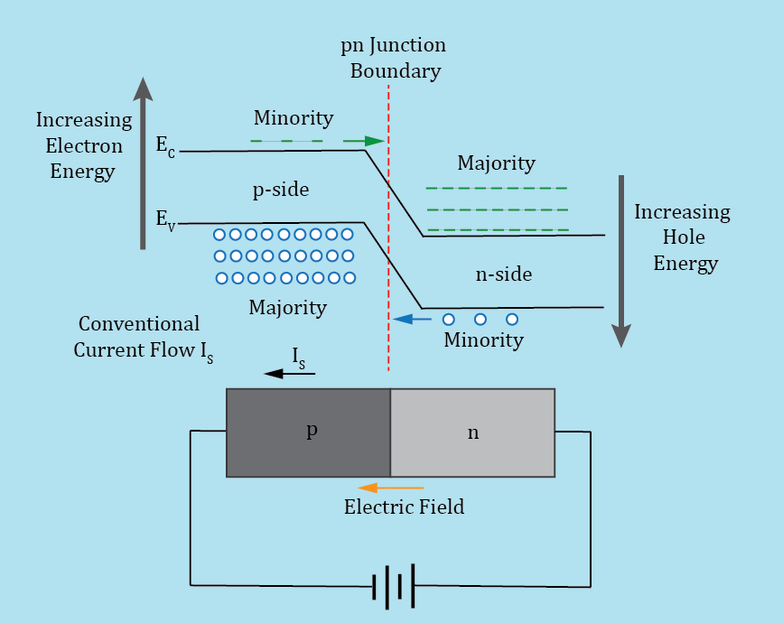
pn Junction Diode – Reverse Bias
With reverse bias, more work is required to move conduction
band electrons from the n-side to the p-side.
Reverse bias widens the depletion region and increases the
barrier potential between the n and p-side of the junction.
For a reverse biased pn junction, the depletion region inhibits
majority carriers from crossing the junction, while aiding minority
carriers to cross the junction.
A relatively small conventional current, referred to as reverse
saturation current I_{s}, flows in a reversed biased pn junction diode.
I_{s} consists mostly of minority carriers in the vicinity of the depletion
region crossing the junction. Saturation refers to the fact that I_{s}
reaches a maximum value under reverse bias, only slightly increasing with increasing reverse voltage.
I_{s} is strongly temperature dependent because minority carrier concentration is strongly temperature dependent.
I_{s} approximately doubles for every 10 ˚C increase in temperature.
For a typical silicon pn junction diode at 25˚C , I_{s} << 1 µA.

Slide 16
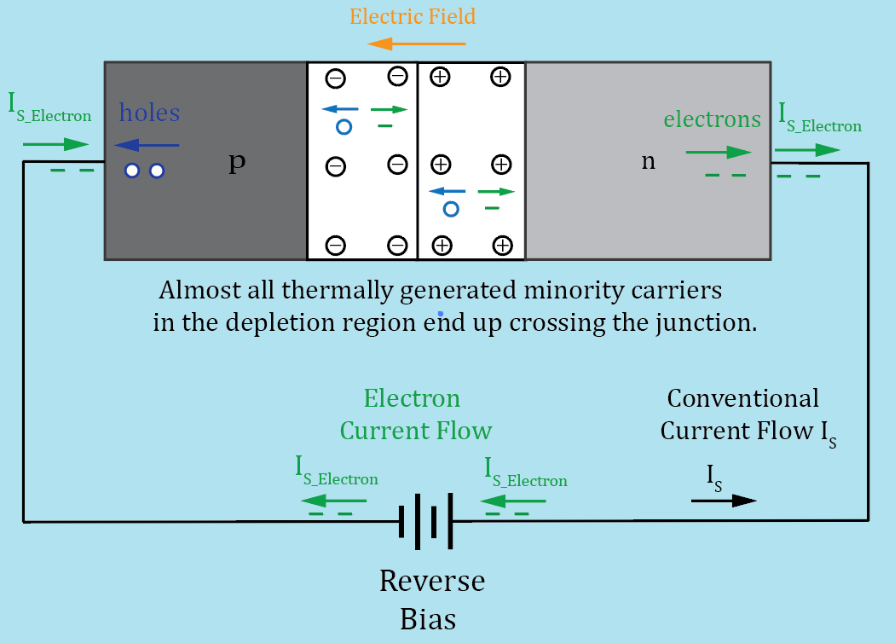
pn Junction Diode – Reverse Bias (Continued)
Thermally generated minority carriers crossing the junction
result in excess electrons on the n-side and excess holes on the
p-side of the junction.
Excess electrons leave the n-side of the diode and return to the
positive terminal of the external battery.
An equal number of electrons leave the negative terminal of the
battery and enter the p-side of the diode, recombining with the
excess holes.
Thermal generation of electron-hole pairs and recombination
are inverse processes.
I_{s} is strongly temperature dependent because minority carrier concentration is strongly temperature dependent.
I_{s} approximately doubles for every 10 ˚C increase in temperature.
Silicon solar cells utilize photons to generate minority carriers in the depletion region, resulting in a significant I_{s} current, and associated voltage that can be used to power an external load.

Slide 17
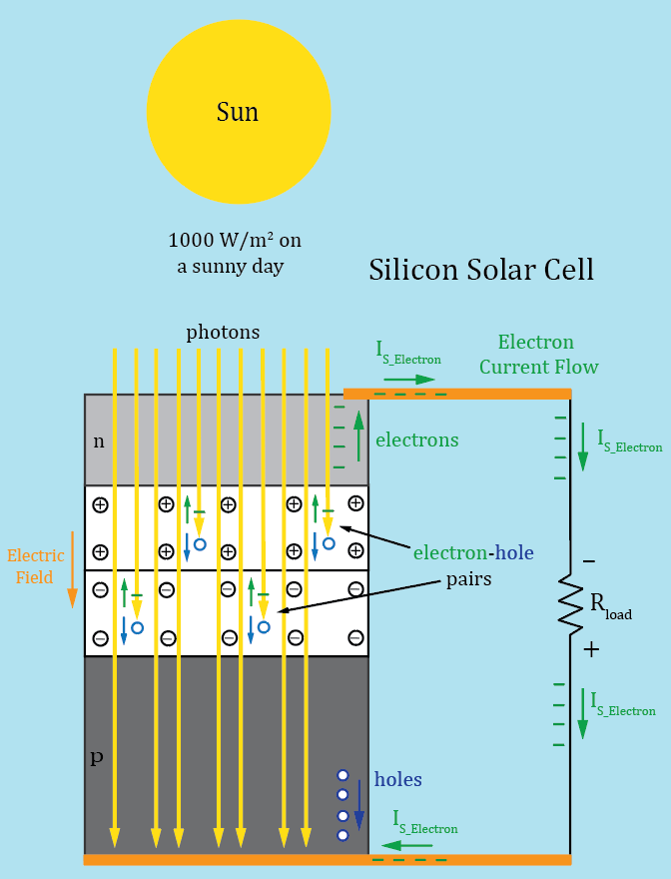
Silicon pn Junction Solar Cell
Photon generated minority carriers crossing the junction
result in excess electrons on the n-side and excess holes on the
p-side of the junction.
Excess electrons leave the n-side of the solar cell, flowing through
the load, then enter the p-side of the solar cell, recombining with
excess holes.
Each solar cell produces a voltage ranging from 0.5 V to 0.6 V
when exposed to sufficient sunlight.
Multiple cells are connected in series to produce a string or
module.
Multiple modules are connected in series and parallel to
produce solar arrays.
Typical solar panel efficiency is < 20%.

Slide 18
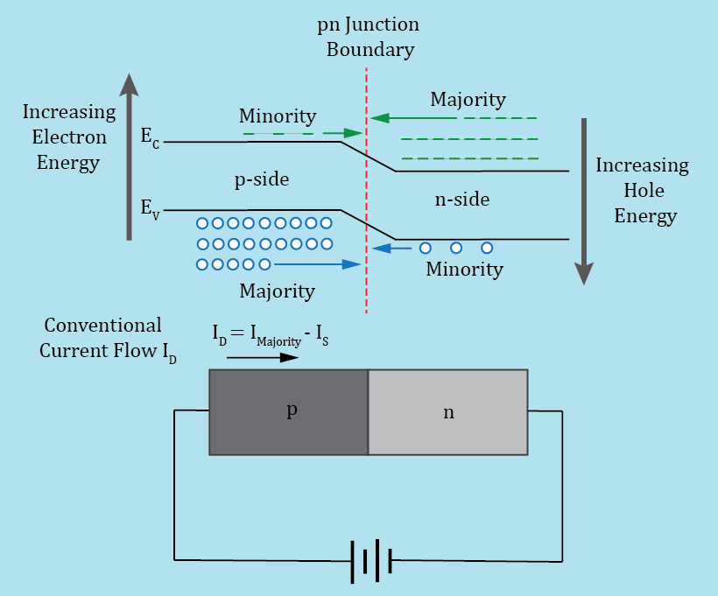
pn Junction Diode – Forward Bias
An externally applied voltage that narrows the depletion
region, decreasing the energy band difference and therefore
voltage difference across the junction, is referred to a forward bias.
Forward bias occurs when the p-type region is connected to a
more positive voltage than the n-type region of a pn junction diode.
Forward bias causes an exponential increase in the number
of majority carriers crossing the pn junction, due to a decrease
in the energy band differences at the junction. g across the
junction.
Consequently, diode current I_{D} increases exponentially with
increasing forward bias voltage applied to a diode.
Both n and p-type majority carriers contribute to the overall conventional diode current I_{D} in forward bias.
The diode reverse saturation current still exists with the forward bias, although the relatively small and opposite direction I_{s} current becomes negligible with respect to the majority carrier current for a forward biased diode equal to or greater than the barrier potential, which is approximately 0.7 V for a silicon pn junction diode.

Slide 19
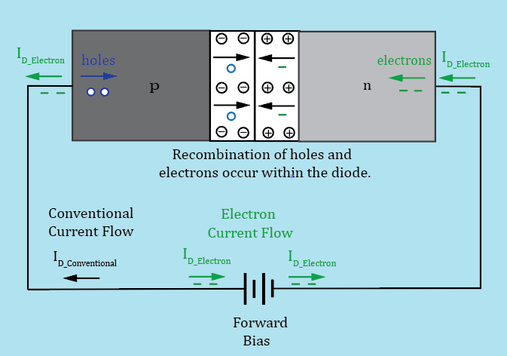
pn Junction Diode – Forward Bias (Continued)
Forward biasing pn junctions results in an exponentially
increasing number of majority carriers crossing the junction.
These majority carriers become minority carriers upon
crossing the junction, resulting in increased electron-hole
recombination occurring within the diode.
Under forward bias, diode current I_{D} flows as follows:
Electrons leave the negative terminal of the battery traveling
through the wire and enter the n-type region as conduction band
electrons. Some conduction band electrons (majority carriers in
n-type region) combine with holes (minority carries in the
n-type region), while others cross the junction to the p-type region. In the p-type region, conduction band electrons are minority carriers and eventually recombine with holes (majority carriers), becoming valence band electrons. Valence band electrons in the p-type region continue movement to the left hoping from hole-to-hole, which can also be viewed as holes, i.e. positive charge, moving to the right. Eventually, valence band electrons reach the left end of the p-type region and move into the wire as free electrons, flowing through the wire to the positive battery terminal.
Within the battery a reduction chemical reaction consumes free electrons at the positive terminal, while an oxidizing chemical reaction produces free electrons at the negative terminal.

Slide 20
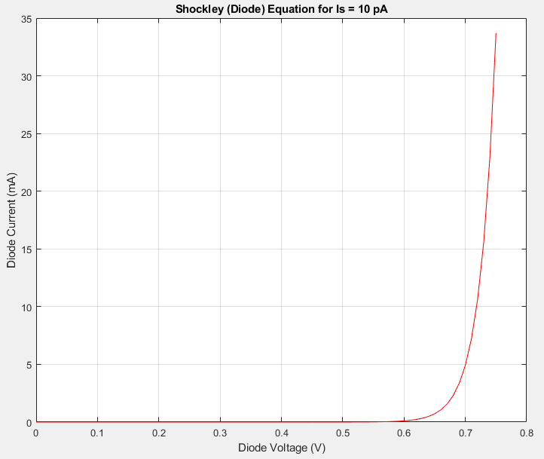
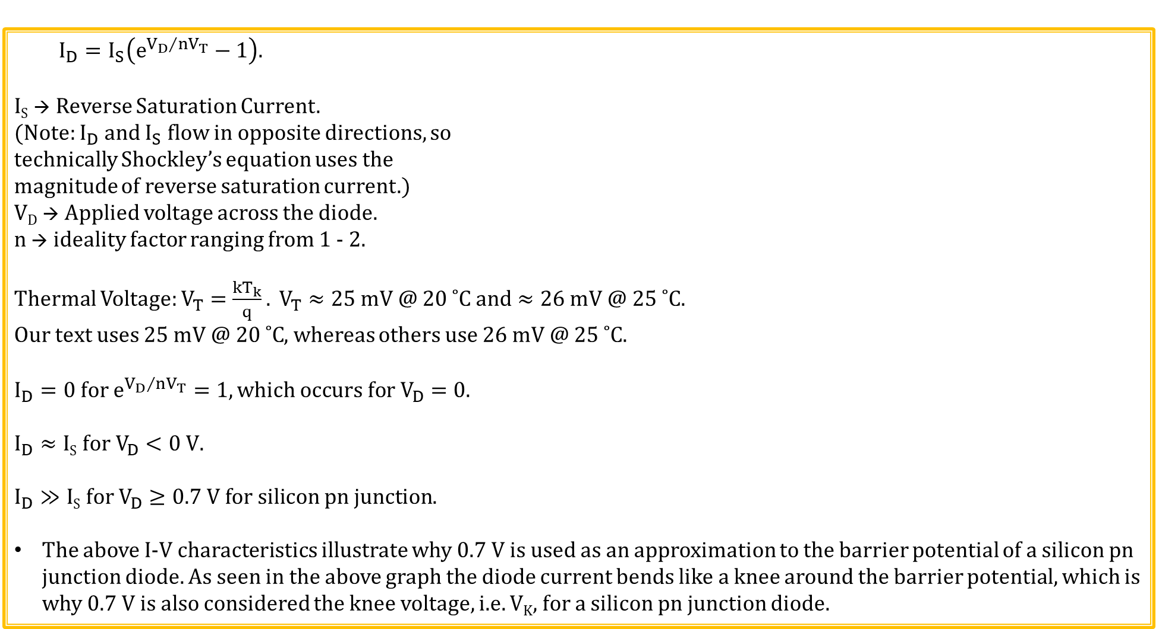
Shockley (Diode) Equation
$$I_{D}=I_{S}\left(e^{{V_{D}}/{nV_{T}}}−1\right).$$
I_{S} → Reverse Saturation Current.
(Note: $I_{D}$ and $I_{S}$ flow in opposite directions, so
technically Shockley’s equation uses the
magnitude of reverse saturation current.)
V_{D} → Applied voltage across the diode.
n → ideality factor ranging from 1 - 2.
Thermal Voltage: $V_{T}=\frac{kT_{k}}{q}. V_{T}≈25 mV @ 20 ˚C and≈26 mV @ 25 ˚C.$
Our text uses 25 mV $@ 20 ˚C$, whereas others use $26 mV @ 25 ˚C.$
$$I_{D}=0 for e^{{V_{D}}/{nV_{T}}}=1, which occurs for V_{D}=0.$$
$$I_{D}≈\text{I}\text{S} \text{for} V_{D}<0 V.$$
$$I_{D}≫\text{I}\text{S} \text{for} V_{D}≥0.7 V for silicon pn junction.$$
The above I-V characteristics illustrate why 0.7 V is used as an approximation to the barrier potential of a silicon pn junction diode. As seen in the above graph the diode current bends like a knee around the barrier potential, which is why 0.7 V is also considered the knee voltage, i.e. V_{K}, for a silicon pn junction diode.

Slide 21
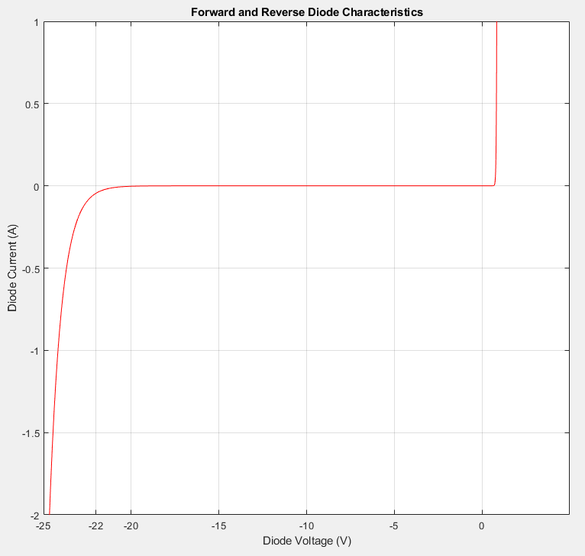
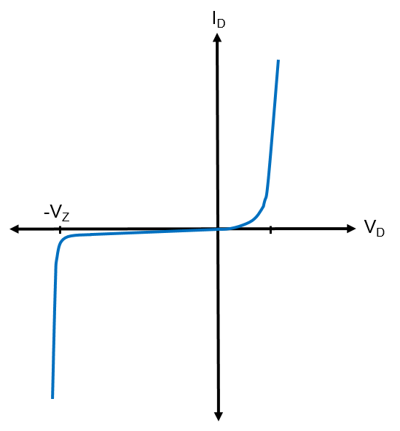
Forward and Reverse Diode Characteristics
Large reverse bias voltages eventually results in a dramatic increase in the reverse saturation current through a process called avalanche breakdown for a standard silicon pn junction diode. Unless current is limited, avalanche breakdown is destructive to the diode because of excessive heating.
The maximum reverse voltage that won’t cause destructive
breakdown is called DC Blocking Voltage (V_{R}), and/or Peak Inverse
(PIV), and/or Peak Repetitive Reverse Voltage (V_{RRM}).
Adjacent diode has a 20 V V_{R} and V_{RRM}.
Special silicon pn junction diodes,
referred to as Zener diodes, are
designed to provide a non-destructive,
well controlled, breakdown voltage.
Zener diodes will be discussed
in more detail later on.

Slide 22
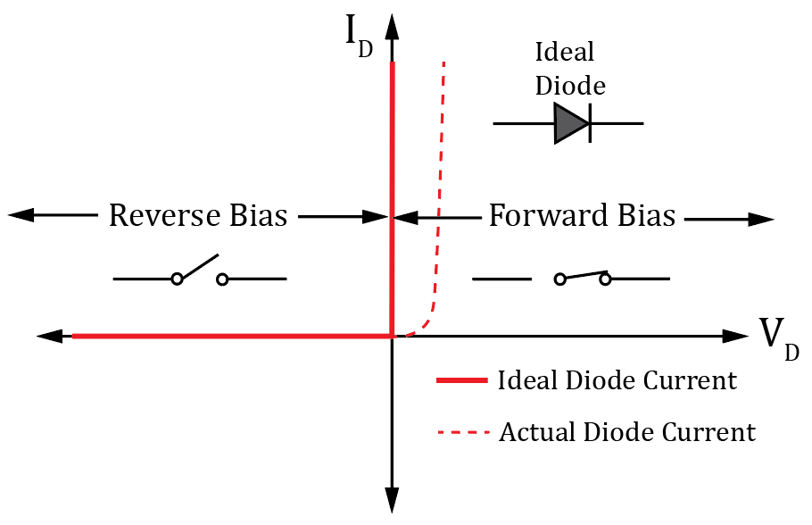
Ideal Diode Model – 1st Approximation
What would you think the ideal diode characteristics would look like?
When forward biased the ideal diode would have 0 V across
it while supporting infinite current, i.e. a closed switch.
When reversed biased the ideal diode would conduct 0 A no
matter how large the applied reverse voltage, i.e. an open switch.
Assume a barrier potential of 0 V for an ideal diode.
Sometimes ideal diode symbol is used to represent an ideal
diode rather than open and closed switches.
Ideal diode model, also referred to as the 1st approximation, is
sometimes used for hand calculations when diode forward bias
voltage is small compared with overall voltage.
For example, for 120 V rms AC line voltage, V_{K} ≈ 0.7 V for a silicon pn junction diode is < 0.5% of the 170 V peak voltage.
Yet V_{K} ≈ 0.7 V for a silicon pn junction diode equals 21 % of a 3.3 V DC voltage.

Slide 23
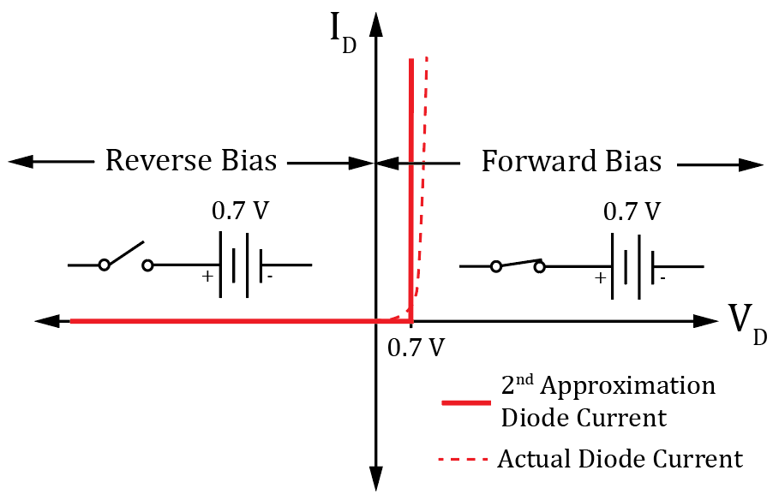
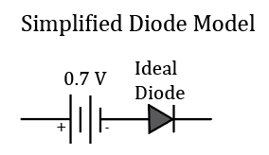
Diode Model – 2nd Approximation
For hand calculations, unless otherwise noted, we will use the 2nd Approximation for diode I-V characteristics, also referred to as the Simplified Diode Model.
For more accurate results than the 2nd Approximation, use LTspice.
For silicon pn junction diode assume a battery voltage of 0.7 V
for the 2nd Approximation.
The battery is simply to indicate that no current flows until
the external applied voltage becomes ≥ the battery voltage.
Reverse bias occurs for the applied diode voltage V_{D} < 0 V.
Forward bias occurs for the applied diode voltage V_{D} > 0 V, although no significant current flows until V_{D} ≥ V_{K} ≥ 0.7 V for a silicon pn junction diode.
In this class consider a diode forward biased for an applied diode voltage V_{D} > 0 V,
which is not a universal definition, i.e. some consider forward bias for V_{D} ≥ V_{K}.
An alternate schematic representation to the open and closed switches is the
adjacent Simplified Diode Model, which is equivalent to the 2nd Approximation.

Slide 24
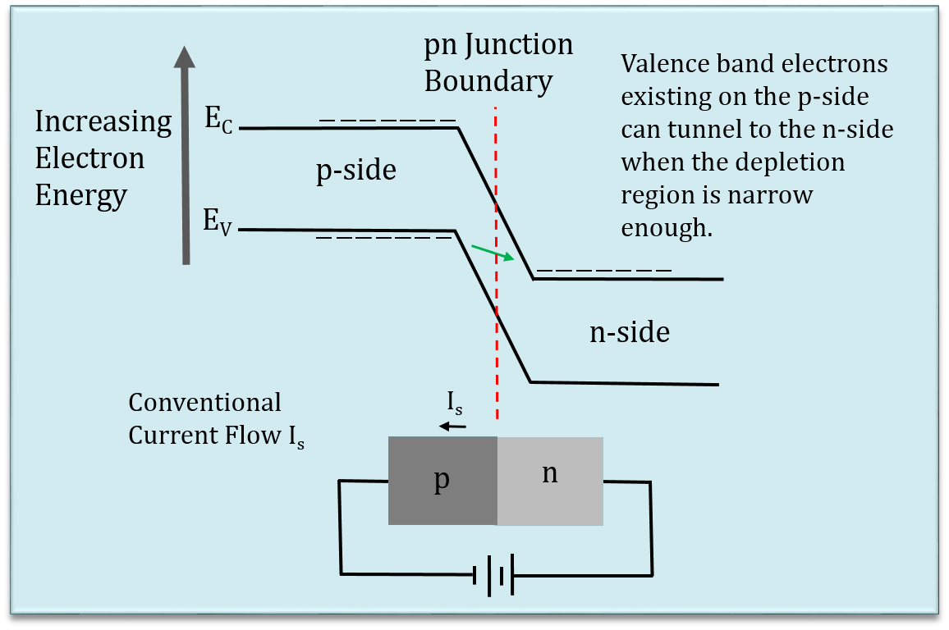
Zener Breakdown Mechanism
Heavy doping results in very
narrow depletion region.
Sufficient reverse bias results in
conduction band electrons on the
n-side having lower energy than
valence band electrons on the
p-side.
Under these circumstances,
valence band electrons can
directly tunnel from p-side to
the n-side.
Low-voltage Zener diodes utilize heavy doping and the Zener breakdown mechanism, whereas high-voltage Zener diodes utilize Avalanche breakdown.
Diode voltage breakdown is non-destructive if current is limited to prevent excessive device heating.

Slide 25
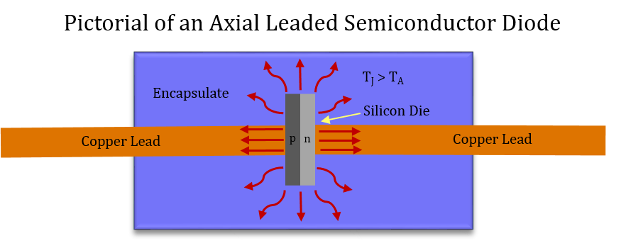
Thermal Resistance
For many semiconductor applications, it is necessary to
calculate maximum, worst-case junction temperature T_{J}, based
on power dissipation, thermal resistance R_{θJA}, and worst-case
ambient temperature T_{A}.
Units of thermal resistance R_{θJA} are ˚C/W.
Multiplying R_{θJA} by device power dissipation gives junction temperature increase in ˚C.
Mathematically: T_{J} = T_{A} + ∆T_{J}, where ∆T_{J} is the increase in junction temperature due to device power dissipation and thermal resistance, i.e. ∆T_{J} = PR_{θJA}.
T_{J} = T_{A} + ∆T_{J} = T_{A} + PR_{θJA}. T_{J} = T_{A} + PR_{θJA}.
For good long-term reliability, want T_{J} less than the recommended maximum operating junction temperature, which has been 150 ˚C for many semiconductor devices.
Nowadays, some semiconductor devices specify 175 ˚C, instead of 150 ˚C as the maximum recommended operating junction temperature. Check the device device datasheet to be sure.

Slide 26
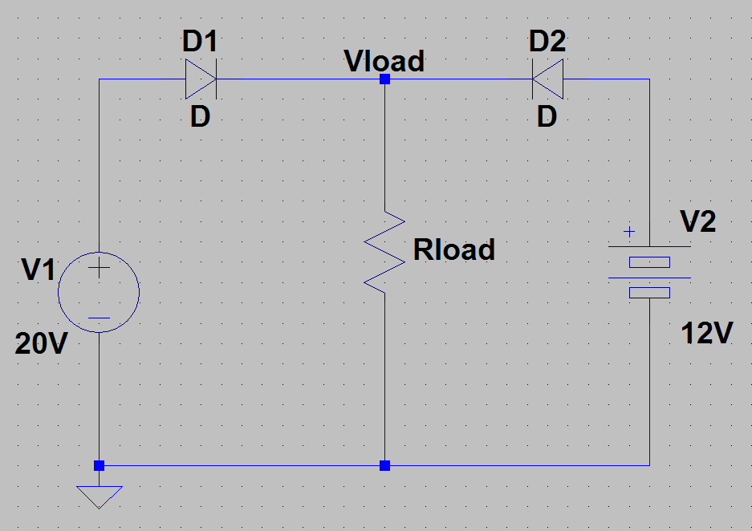
Diode OR
What is the voltage Vload in the adjacent circuit?
For the adjacent circuit D1 will be
forward biased while D2 will be reverse
Biased.
V_{load} = (20 V – 0.7 V) = 19.3 V.
What is the function of the two diodes?
These diodes provide a mechanism so that the largest of the two supply voltages powers the load, effectively disconnecting the smaller of the two supply voltages from the circuit.
This is a simple and convenient way to implement a battery back-up.

Slide 27
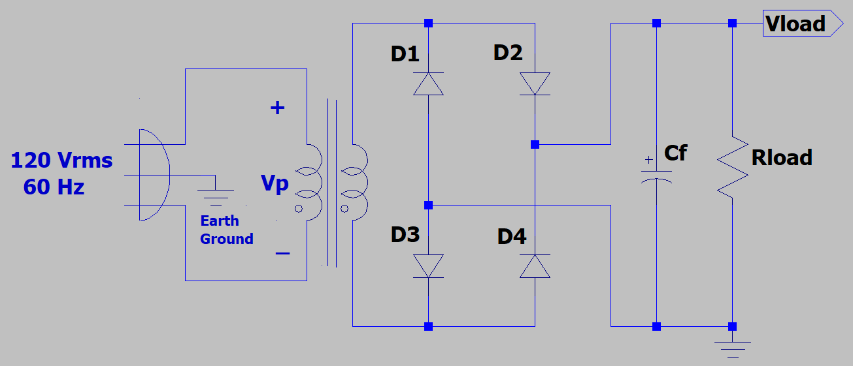
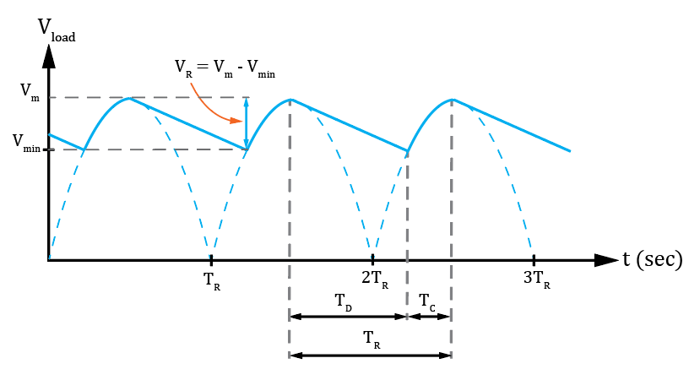
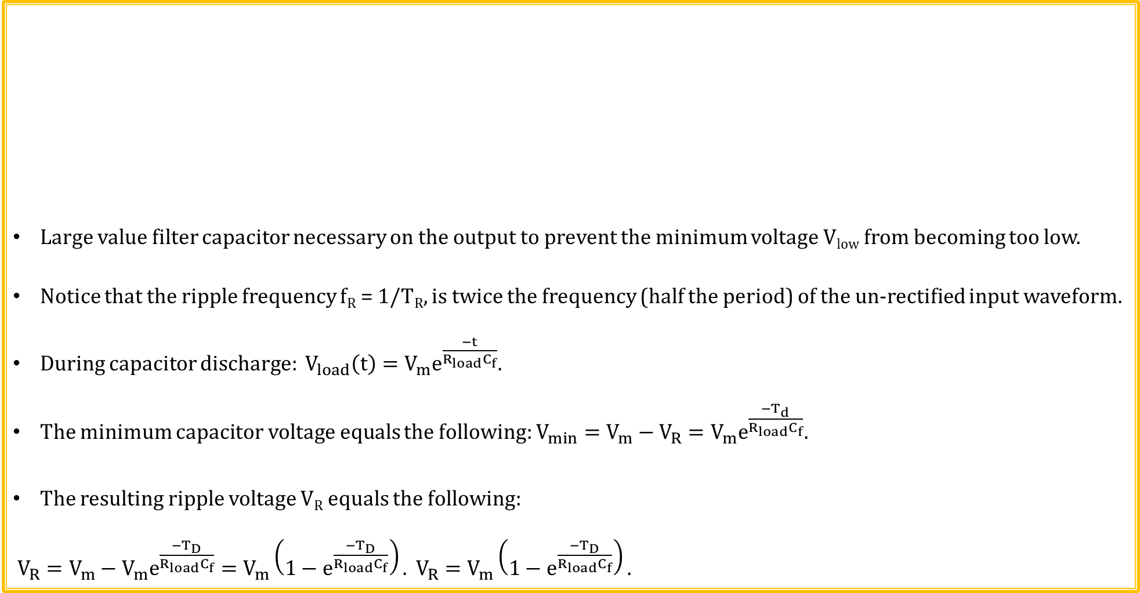
Bridge Rectifier with Filter Capacitor
Large value filter capacitor necessary on the output to prevent the minimum voltage V_{low} from becoming too low.
Notice that the ripple frequency f_{R} = 1/T_{R}, is twice the frequency (half the period) of the un-rectified input waveform.
During capacitor discharge: $V_{load}\left(t\right)=V_{m}e^{\frac{−t}{R_{load}C_{f}}}.$
The minimum capacitor voltage equals the following: $V_{min}=V_{m}−V_{R}=V_{m}e^{\frac{{−T}_{d}}{R_{load}C_{f}}}.$
The resulting ripple voltage V_{R} equals the following:
$V_{R}=V_{m}−V_{m}e^{\frac{{−T}_{D}}{R_{load}C_{f}}}=V_{m}\left(1−e^{\frac{{−T}_{D}}{R_{load}C_{f}}}\right). V_{R}=V_{m}\left(1−e^{\frac{{−T}_{D}}{R_{load}C_{f}}}\right).$

Slide 28
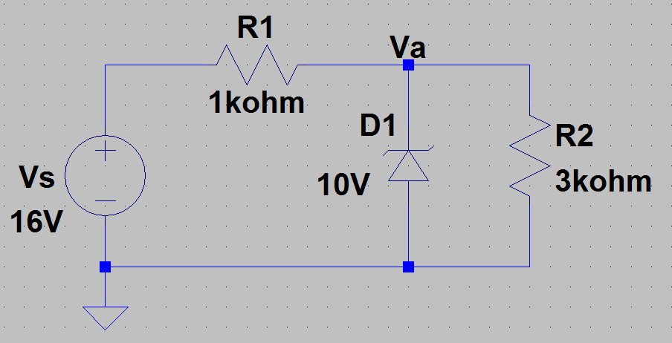
Zener Diodes Circuit Example 2
Determine I_{Z} in the adjacent circuit.
Need to 1st determine region of operation
in order to apply the right model.
With D1 removed, V_{a} = (16 V)(3 kΩ)/(4 kΩ) = 12.0 V.
Therefore, operating in Zener breakdown and V_{a} = V_{Z} = 10.0 V.
I_{R1} = (16 V – 10 V)/(1 kΩ) = 6 mA. I_{R2} = (10 V)/(3 kΩ) = 3.33 mA.
By KCL, I_{Z} + I_{R2} = I_{R1}. I_{Z} = I_{R1} - I_{R2} = 2.67 mA.
I_{Z} = 2.67 mA.

Slide 29
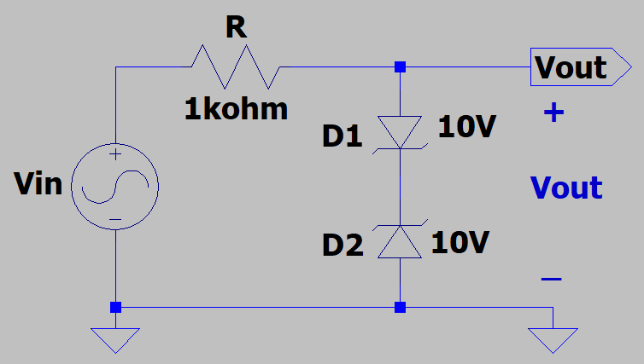
Zener Diodes Circuit Example 3
Assuming that V_{in} provides a sine wave with 0 dc offset voltage
and that V_{m} = 20 V. Determine the following voltages using the
2nd approximation, i.e. simplified diode model.
What is the maximum output voltage V_{out_max} = ?
V_{out_max} = 0.7 V + 10 V = 10.7 V.
What is the minimum output voltage V_{out_min} = ?
V_{out_min} = -0.7 V -10 V = -10.7 V.
For V_{m} = 10 V, what is V_{out_max} and V_{out_min} = ?
V_{out_max} = V_{m} = 10 V. V_{out_min} = -V_{m} = -10 V.

Slide 30
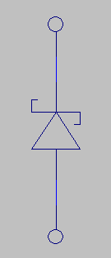
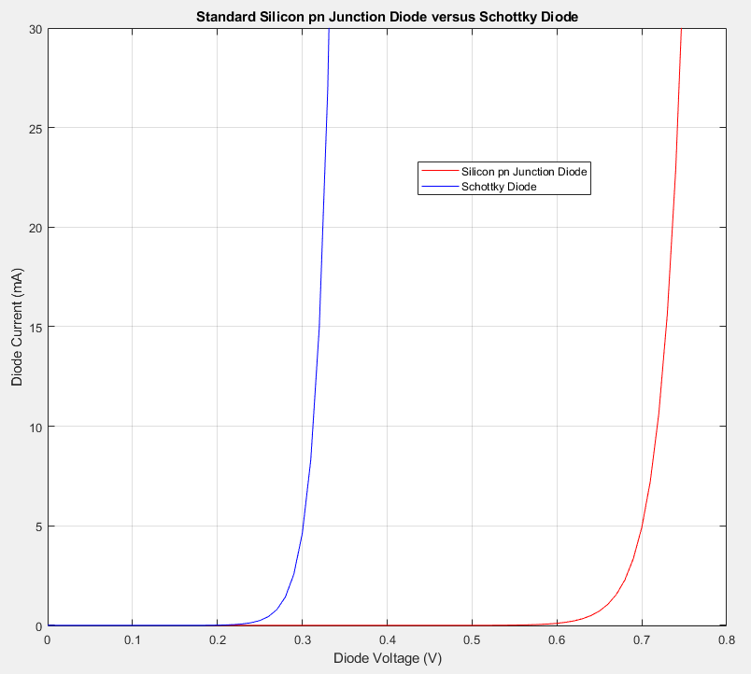
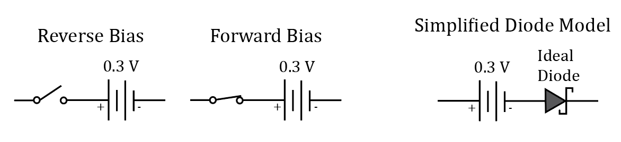
Schottky Diodes (Continued)
Schottky diode symbol uses a square S shaped cathode.
Schottky diodes do not have a depletion region and essentially no
minority carriers, resulting in greatly reduced reverse time compared
with silicon pn junction diodes.
Assume the following 2nd Approximation, i.e. Simplified Diode Model
for hand calculations for Schottky Diodes.
Reverse leakage current is noticeably higher for Schottky diodes as compared
with standard silicon pn junction diodes.
Due to ongoing improvements in reverse leakage current and Peak Repetitive Reverse Voltage (V_{RRM}), Schottky diodes continue to displace silicon pn junction diodes in many applications.

Slide 31
The End

Slide 32
Extra

